Slide 1

Course Web Site
Information for this class is located on http://www.afsenyc.org/csprinciples. Students should log in and retrieve technical data when entering the classroom. There will be quizzes to take on the web site. Assignment details and submit forms are on the web site. We will use the web site to communicate information.

Slide 2


Relevant Feedback
Relevant feedback expresses an understanding of the design that can be useful. Describing how well or how poorly a product is working or would work is useful. Ratings for the latest sneakers that say “I like pie!” are irrelevant.

Slide 3

Specific Feedback
Specific feedback gives a measurable and precise description that can be useful for improving. The feedback will avoid vagueness that could be applied to many different subjects. Saying that something is “nice” or “bad” is unspecific. Outlining an exact change that can be made to improve is specific.

Slide 4
Actionable Feedback
Actionable feedback means that the feedback can lead to something that can be done. Saying that this icecream is better with sprinkles is helpful. Saying this icecream would be better on the moon is not. If you give some one feedback that suggests something that can’t be done, it isn’t actionable.

Slide 5
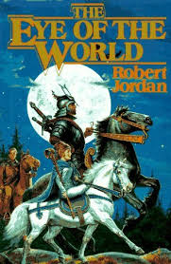
Feedback Case Study 1
This sandwich was awesome bruh. It needs lasers. My dog ate my homework bruh but I don’t care. Have you seen my socks?

Slide 6

Feedback Case Study 2
I started running approximately 3 years ago when I lost 50 pounds. I knew nothing of running shoes so I went to my local sporting goods chain and tried on about 40 pair before deciding on the Gel-Cumulus 12s. I finally wore those out this year (I'm a social runner, not competitive) so I knew I needed to get some new shoes.

Slide 7

Feedback Case Study 3
The staples holding the pillow together cut me. Maybe you should use something less sharp? Also, there was little filling inside. I suggest doubling the amount of feathers used.

Slide 8
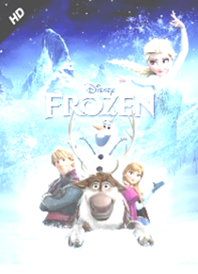
Feedback Case Study 4
Sorry but I didn't like it at all. I felt like I kept waiting for something more but nothing came. The plot was very thin and Anna was just too ditzy for me. After Elsa's signature song, Let it Go, which I find to be very overrated, you would think that she would've went back to the town as a strong woman but she just locked herself back up. Not only is this not the best Disney movie of all time, it's not the best Disney movie of this decade (Tangled)!! Please don't disrespect The Lion King, The Little Mermaid, Aladdin, etc...like that. Let's also not forget that it's not the 1st Disney movie about the love of sisters or family (Lilo & Stitch, Brave).

